Slide 1
2.2. Machine Learning & its Types
Supervised • Unsupervised • Reinforcement Learning

Slide 2







Machine Learning
ML is a subset of AI where systems learn patterns from data and improve automatically without being explicitly programmed.
Email spam filters
Credit Card Fraud Detection
Recommendation System

Slide 3






Types of Machine Learning
01
02
03
Supervised Learning
Unsupervised Learning
Reinforcement Learning
Learns from labeled data to predict outcomes for new inputs.
Finds hidden patterns or structures in unlabeled data.
Learns by interacting with an environment through rewards and penalties.

Slide 4



Supervised Learning
Supervised Learning is a type of ML where models are trained on labeled datasets — meaning each input has a known output.
Email spam filters
House Price Prediction
Image Recognition

Slide 5




Unsupervised Learning
Unsupervised Learning deals with unlabeled data. The system tries to identify hidden patterns or structures in the data without knowing the correct answers.
Customer Segmentation
Market Basket Analysis
Gene Clustering in Biology

Slide 6
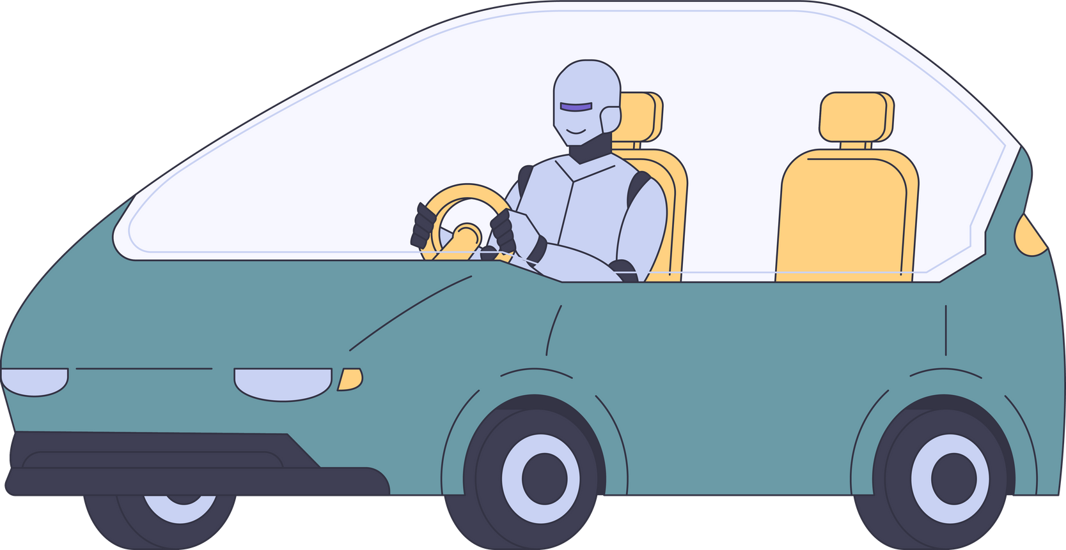



Reinforcement Learning
Reinforcement Learning is a type of Machine Learning where an agent learns by interacting with an environment — taking actions, receiving rewards or penalties, and improving its strategy over time.
Game Playing (Chess, Go)
Self-Driving Cars
Robot Navigation

